Slide 1



Text Classification using NLP Methods
Team Members:
Saikumar Dacharla
Thumma Karthik reddy

Slide 2
Introduction
In this project, we aim to compare three prominent deep learning architectures for text classification: Convolutional Neural Networks (CNNs), Long Short-Term Memory (LSTM) networks, and Bidirectional Encoder Representations from Transformers (BERT).
Each of these architectures offers unique advantages and capabilities, making it crucial to understand their performance characteristics and suitability for different text classification tasks.
Through this comparative analysis, we seek to answer key questions such as:
How do CNNs, LSTMs, and BERT differ in their approach to text classification?
Which model architecture yields the highest accuracy and generalization performance?
What insights can we gain from comparing the training dynamics and evaluation metrics of these models?

Slide 3
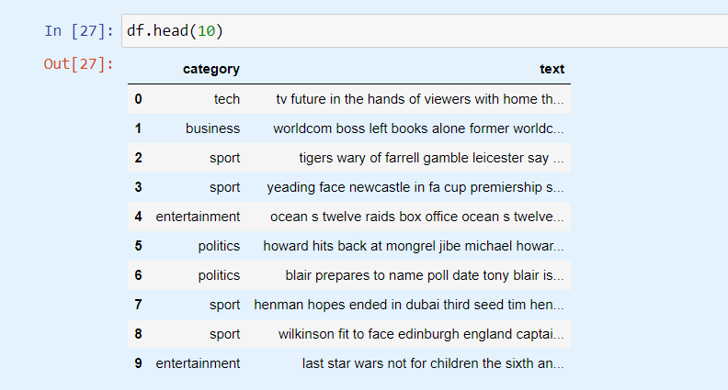
Dataset Overview

Slide 4
Data pre-processing
1.Loading dataset:
The dataset is loaded using the ‘pd.read_csv()’ function from the pandas library.
The dataset contains text documents along with their corresponding categories or labels.
2.Shuffling the dataset:
To ensure randomness and prevent any bias during training, the dataset is shuffled using the ‘sample()’ function in Pandas.

Slide 5
3.Text and label Preprocessing:
Before feeding the text data into the models, it's essential to preprocess the text and labels.
The text column is converted to string format to handle any non-string values.
The data is split into text and label components, with the text data stored in a separate
variable(text_data)and the labels in another variable (‘labels’).
Labels are encoded using the ‘Tokenizer’ from Scikit-learn to convert categorical labels into numerical format, which is required for training the models.

Slide 6
4.Tokenization and Padding:
The text data is tokenized using the ‘Tokenizer’ class from Keras, which converts text documents into sequences of integers, where each integer represents a unique word in the vocabulary.
After tokenization, the sequences are padded to ensure uniform length using the ‘pad_sequences’ function from Keras. This step is necessary because deep learning models require inputs of fixed length.
5.Train-Test Split:
Finally, the dataset is split into training and test sets using the ‘train_test_split()’ function from Scikit-learn. This step ensures that the models are trained on a subset of the data and evaluated on unseen data to assess their generalization performance.

Slide 7
Methods Used
1. Convolutional Neural Network (CNN) Model
Architecture Description: The CNN model consists of layers such as Embedding, Conv1D, MaxPooling1D, Flatten, Dense, and Dropout. These layers are designed to capture hierarchical features from the text data.
Training Process: The model is trained using the ‘fit’ function with the training data. During training, the model learns to minimize the loss function (sparse_categorical_crossentropy) and optimize the parameters using the Adam optimizer.
Evaluation Results: After training, the model's performance is evaluated on the test data using the ‘evaluate’ function. The accuracy and loss metrics are computed to assess the model's classification performance.
Example Predictions: Example predictions are made on a subset of test data, and both actual and predicted categories are displayed. This allows for a qualitative assessment of the model's predictions.
Visualization: Training and validation accuracy and loss values are visualized using line plots to provide insights into the model's learning dynamics and generalization performance over epochs.

Slide 8
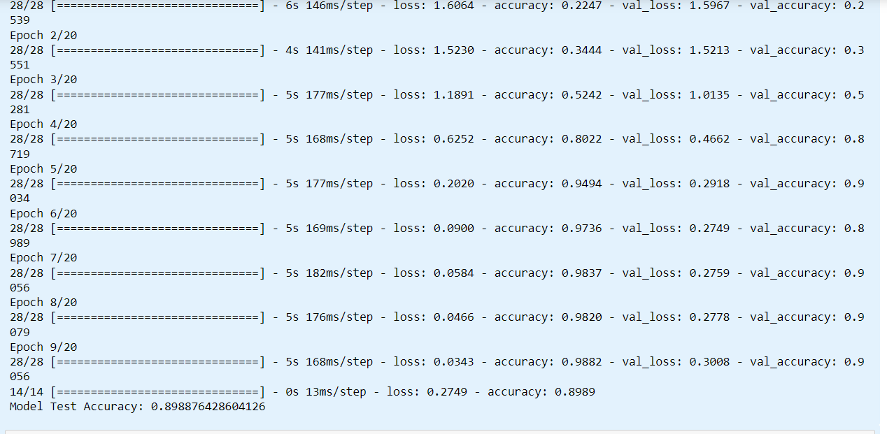
Model Test Accuracy on Train data

Slide 9
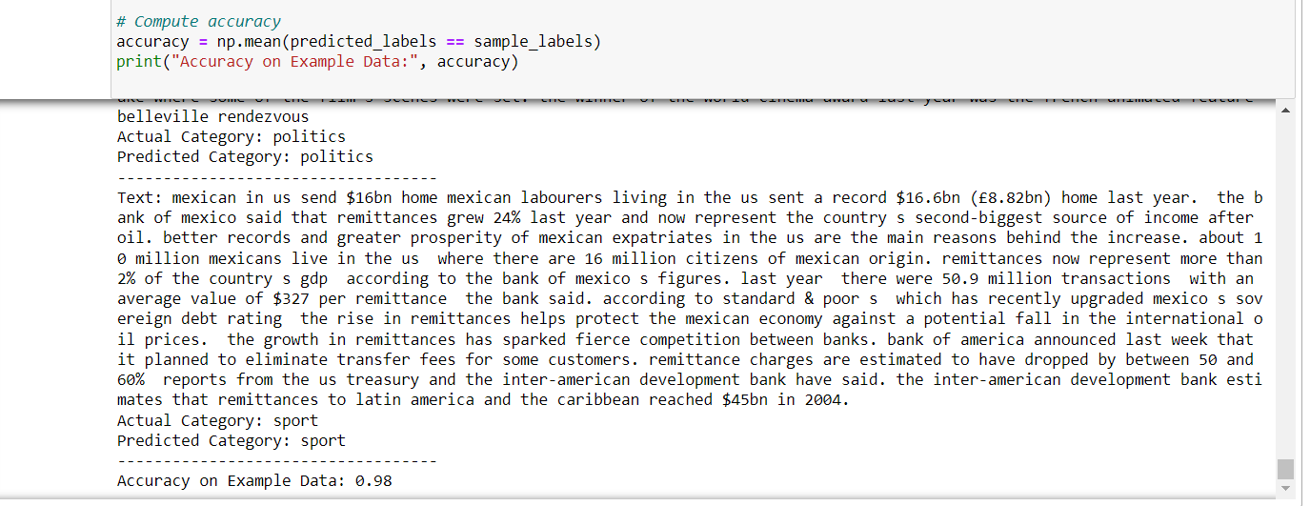
Accuracy on Example Data

Slide 10
Long Short-Term Memory (LSTM) model:
Architecture: LSTM architecture is described, featuring Embedding and LSTM layers followed by a Dense layer for classification.
Training: The model is trained using ‘fit’, optimizing parameters with Adam optimizer to minimize sparse categorical crossentropy loss.
Evaluation: Model performance is assessed on test data with ‘evaluate’ , calculating accuracy and loss metrics.
Example Predictions: Example predictions are made on a subset of test data, displaying actual and predicted categories for qualitative assessment.
Visualization: Training and validation accuracy and loss are visualized to understand the model's learning dynamics and generalization over epochs.

Slide 11
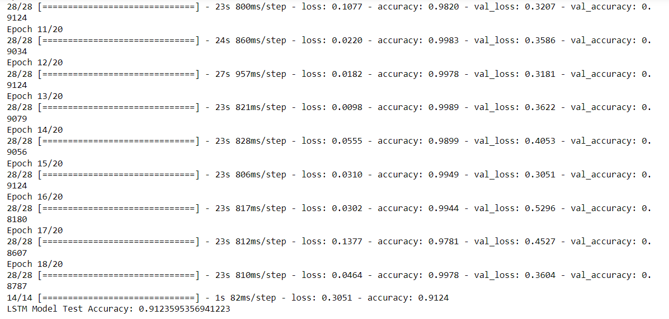
LSTM Model Test Accuracy

Slide 12

Accuracy on Example data for LSTM

Slide 13
BERT Model
Architecture: BERT model architecture is outlined, leveraging pre-trained BERT embeddings and a classification layer for text classification.
Training: Training occurs with ‘fit()’ function, optimizing parameters using Adam optimizer to minimize sparse categorical crossentropy loss.
Evaluation: Model performance is gauged on test data with ‘evaluate’ , computing accuracy and loss metrics.
Visualization: Training and validation accuracy and loss are plotted to grasp the model's learning dynamics and generalization trends over epochs.

Slide 14
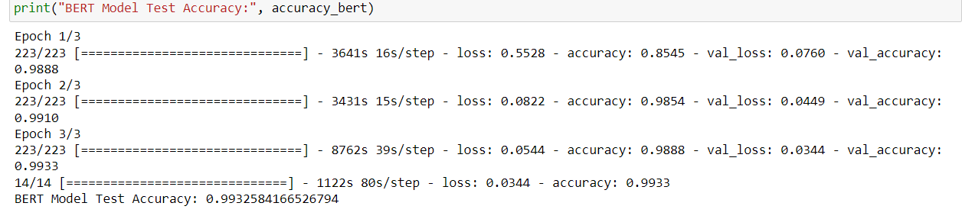
BERT Model Test Accuracy

Slide 15
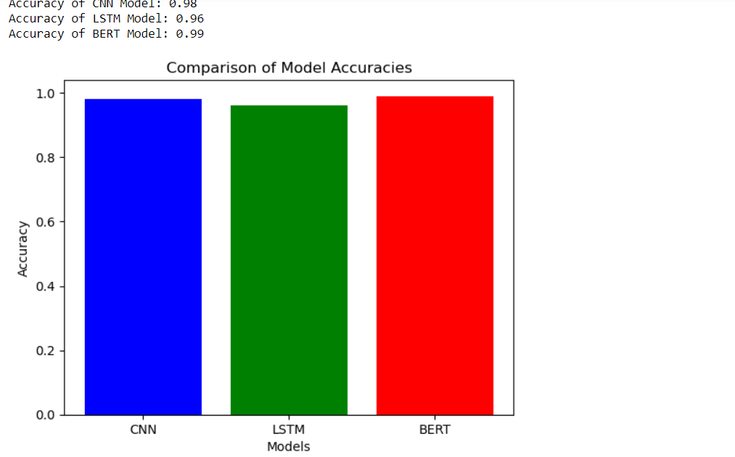
Model Comparison

Slide 16
Conclusion

